Slide 1
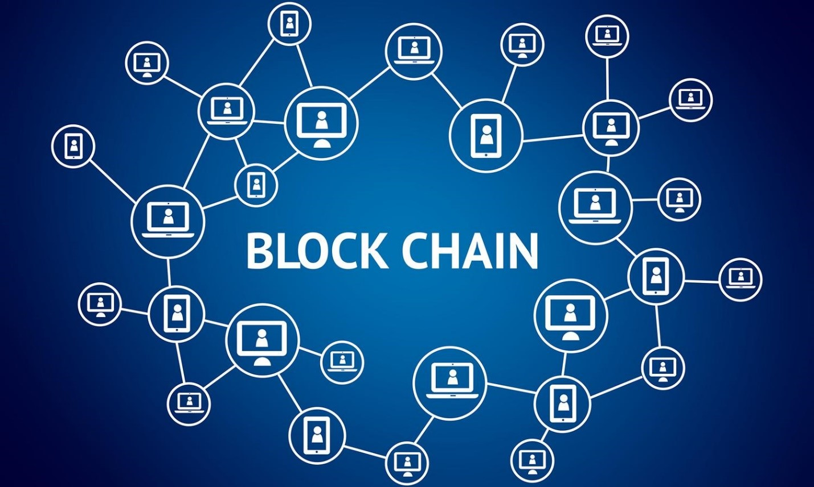

Slide 2
THE BLOCKCHAIN:
TRUSTWORTHY TRANSACTIONS IN A TRUSTLESS WORLD

Slide 3
Agenda
1
Blockchain
2
Bitcoin
3
Smart Contract

Slide 4

Some Definitions
A database or a ledger that maintain a continuously growing list of data records of transaction
A decentralize ledger of all transactions across a peer-to-peer network
A hash pointer linked list of blocks
Blockchain

Slide 5
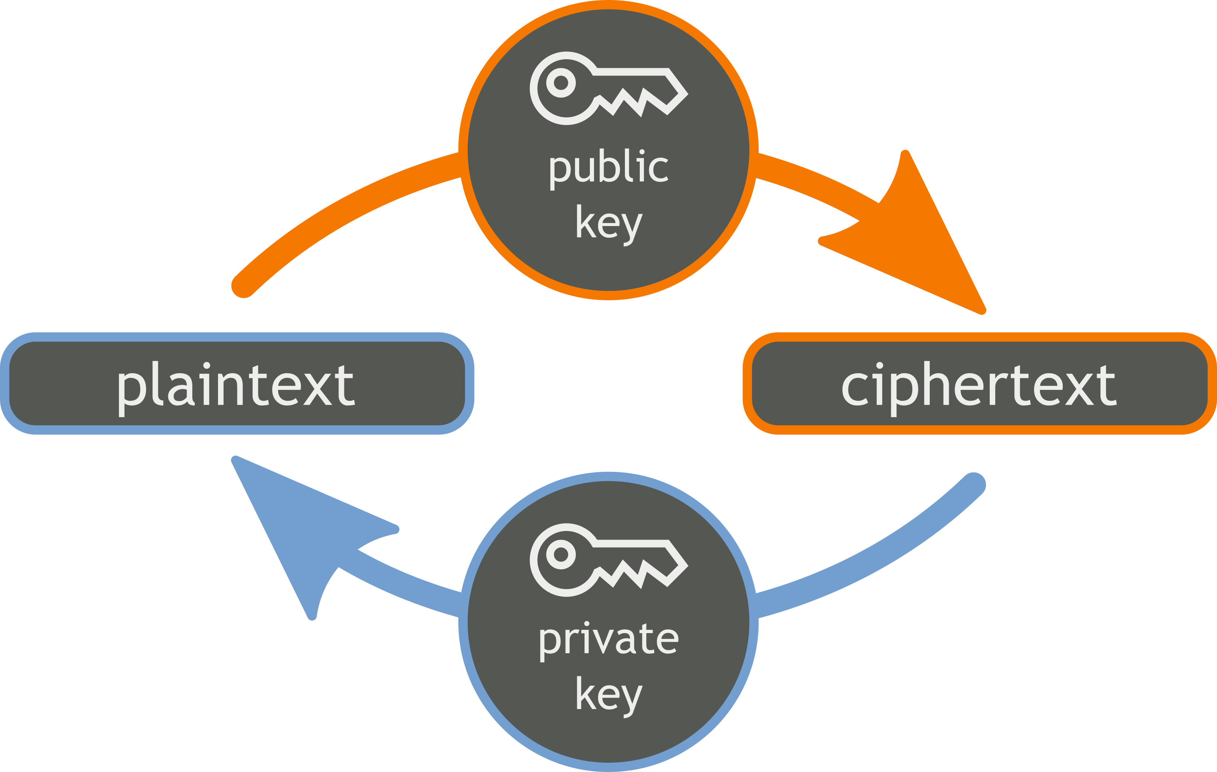
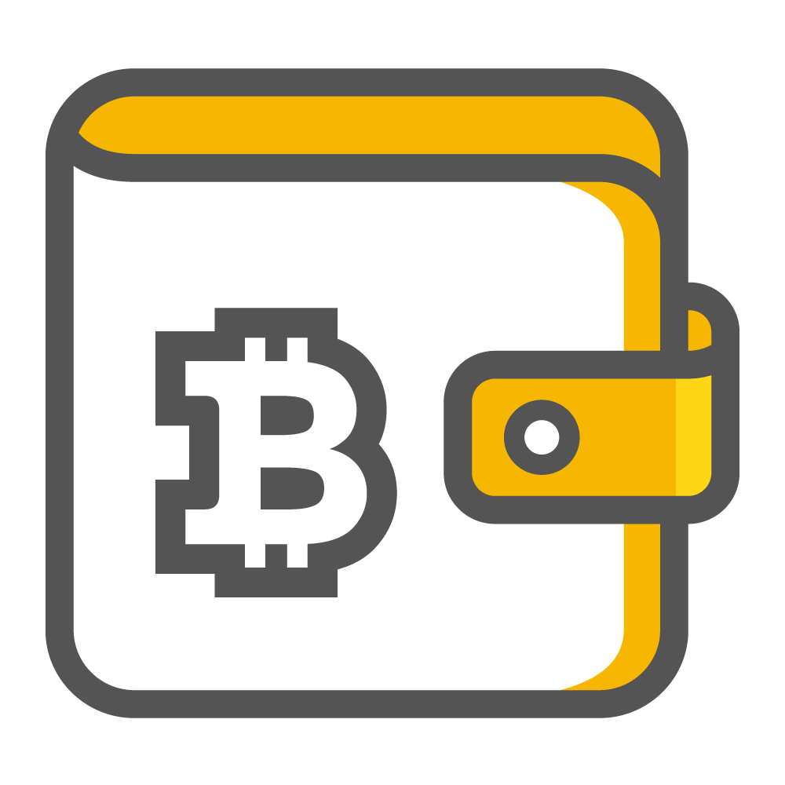
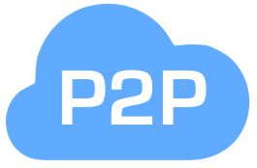
Requisite Knowledge
Wallet a program that alows you to store and exchange your Bitcoins
Symmetric cryptography once data is encrypted with a given key, there is no fast way to decrypt the data without possessing the other key
Peer-to-peer (P2P) a decentralized communications model in which each party has the same capabilities and either party can initiate a communication session

Slide 6
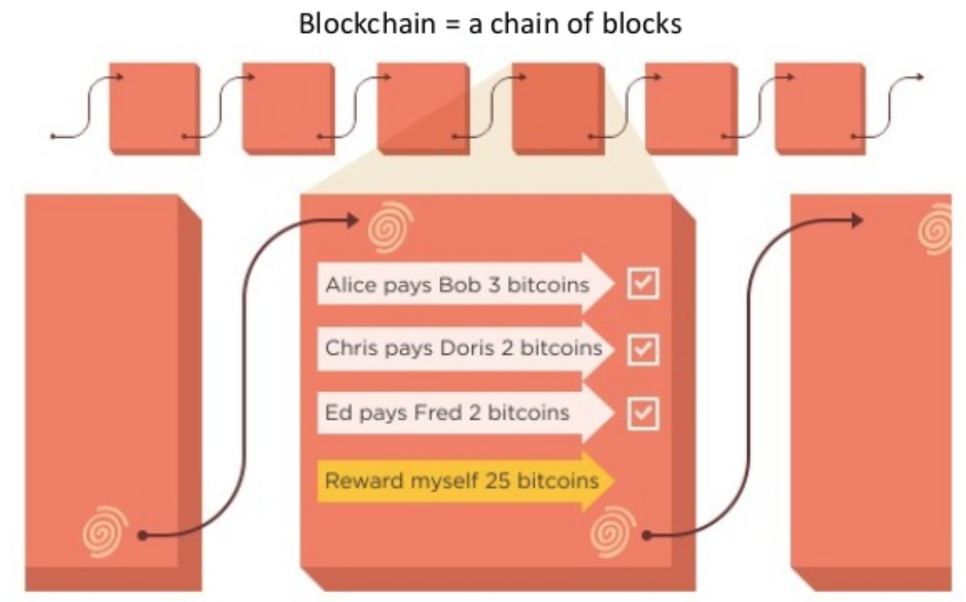
Blockchain Fundamental

Slide 7
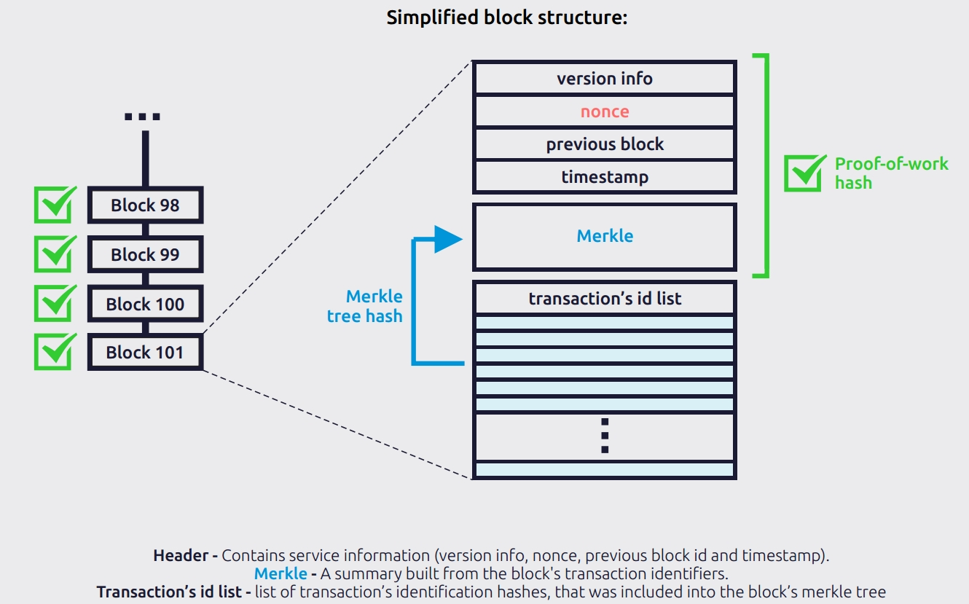
What does a block looks like

Slide 8
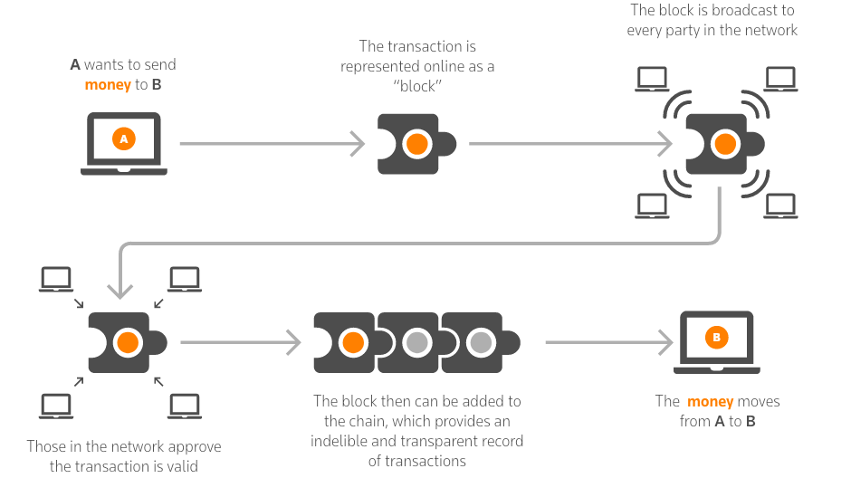
How BlockChain works

Slide 9
How Safe Are Blockchains?
If an miner wants to modify a intermediate block, all subsequent blocks must be modified too.
An external hacker would have to gain access to every computer that holds a copy of the blockchain database, and at the same time, in order to tamper with it.
While all the finalized transactions are available for everyone to see, the personal information stays hidden.

Slide 10
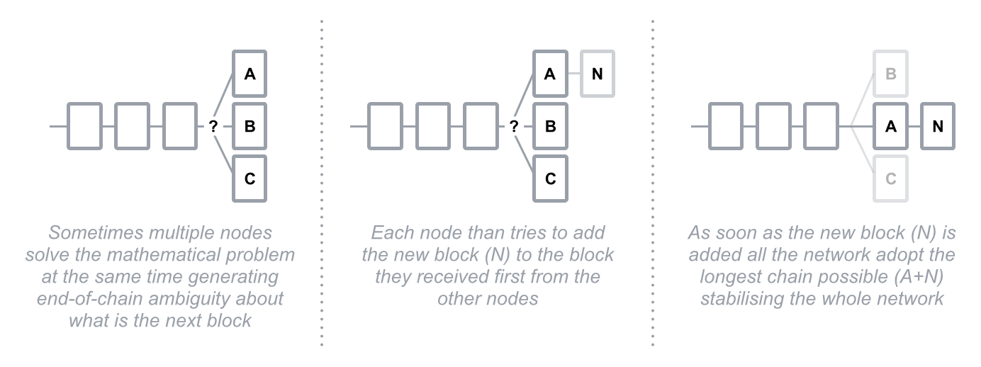
How Safe Are Blockchains?
End of chain ambiguity logic

Slide 11
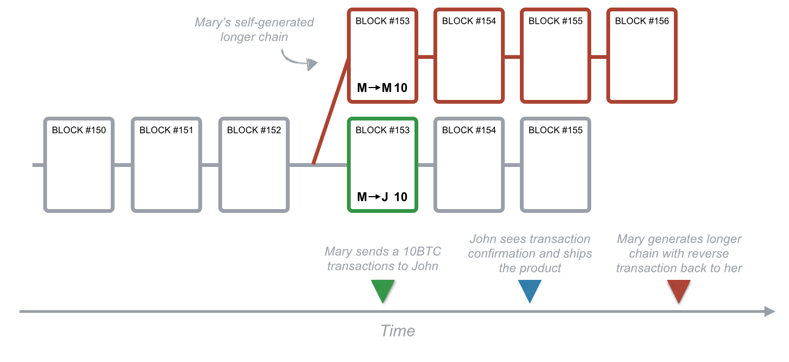
How Safe Are Blockchains?
Transactions in the Bitcoin blockchain system are protected by a mathematical race: any attacker is competing against the whole network.

Slide 12




Why is blockchain useful?
Trustless
Immutable
Decentralized
Improved Market Access
Blockchain allows digital transactions to happen between parties who do not trust each other.
Once a transaction is agreed and shared across the distributed network it becomes close to impossible to undo
No single authority has control.
The system removes the need for intermediaries and thus lower transaction costs.
Global markets have the potential to become even more easily accessible to investors and issuers

Slide 13



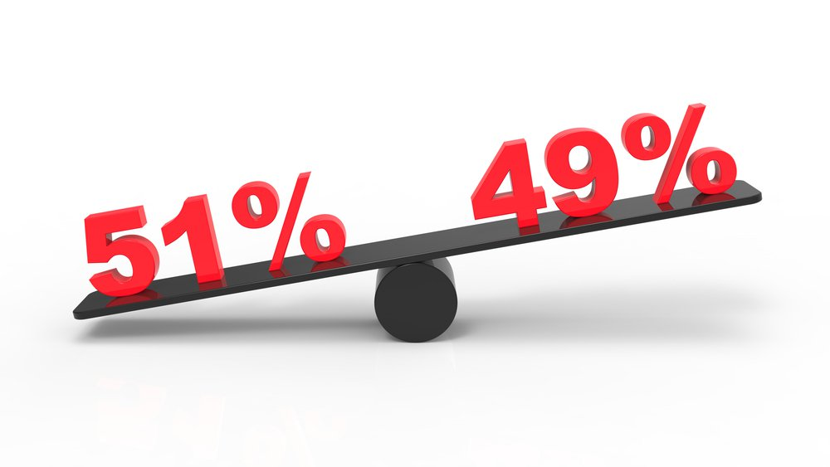
challenges of blockchain
Wasteful
Network speed/cost
Lack of privacy
51% attack
every node repeats a task to reach Consensus burning electricity and time on the way.
Since a Bitcoin block is created roughly every 10 minutes, the maximum number of possible transactions is very limited.
Transactions are globally published and are not encrypted in most applications. If this data is personal data, this leads to regulatory and legal problems
a potential attack on the bitcoin network whereby an organization is somehow able to control the majority of the network mining power (hashrate)

Slide 14
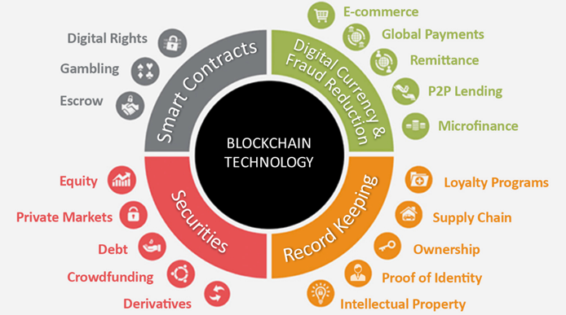
Blockchain Applications

Slide 15
Bitcoin
Bitcoin was first invented by a Satoshi Nakamoto as an open source technology released in 2009
It’s a digital cryptocurrency now accepted worldwide specially in digital payment systems
There are only 21 million Bitcoins that can be mined in total.
1.00 BTC = $14,705.20 (Dec, 23, 2017)
One bitcoin block is computed per 10 mins or so.
Limited to 12.5 BTC per transaction.

Slide 16
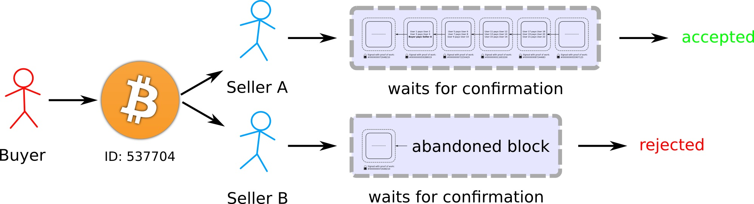
Bitcoin double spending

Slide 17
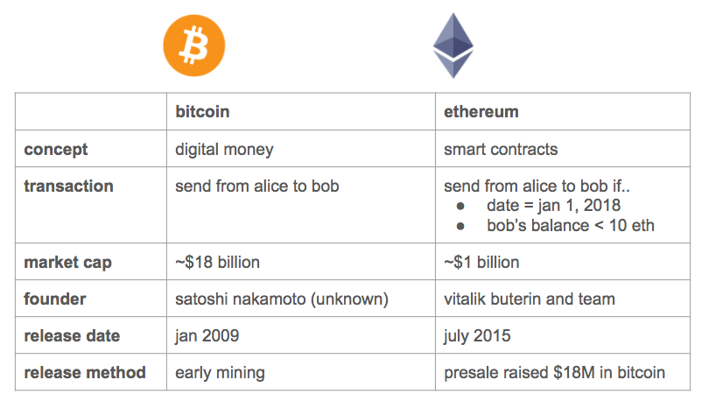
Ethereum

Slide 18
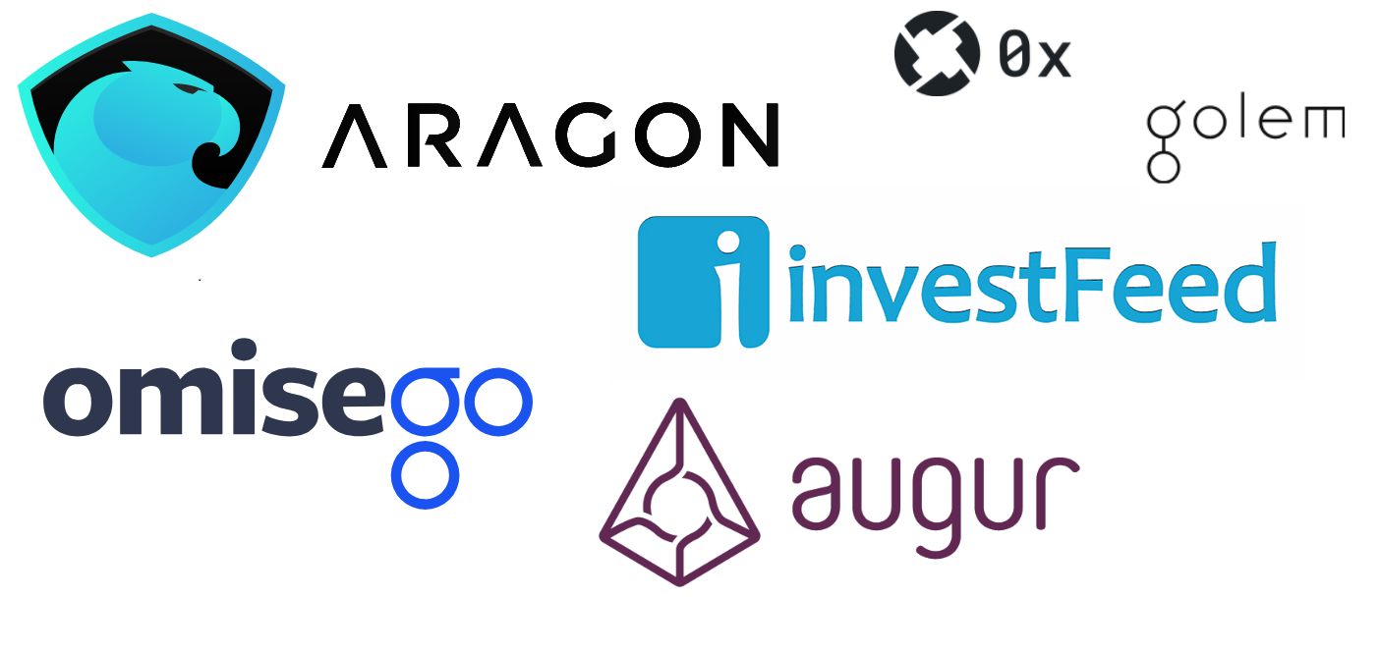
Dapps

Slide 19


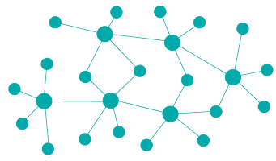

Dapps
Opensource
Decentralized
Rewarding
Protocol
All records of the application’s operation must be stored on a public and decentralized blockchain
Validators of the blockchain should be encouraged by rewarding them
The application community must agree on a cryptographic algorithm

Slide 20
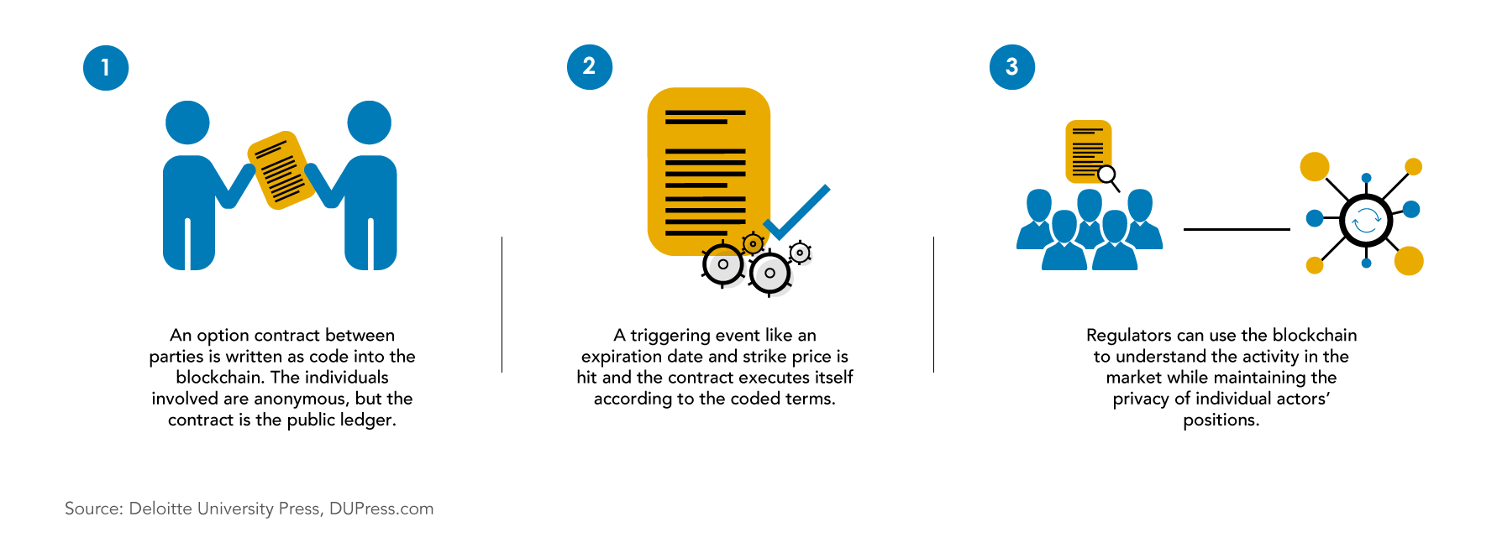
smart contract

Slide 21
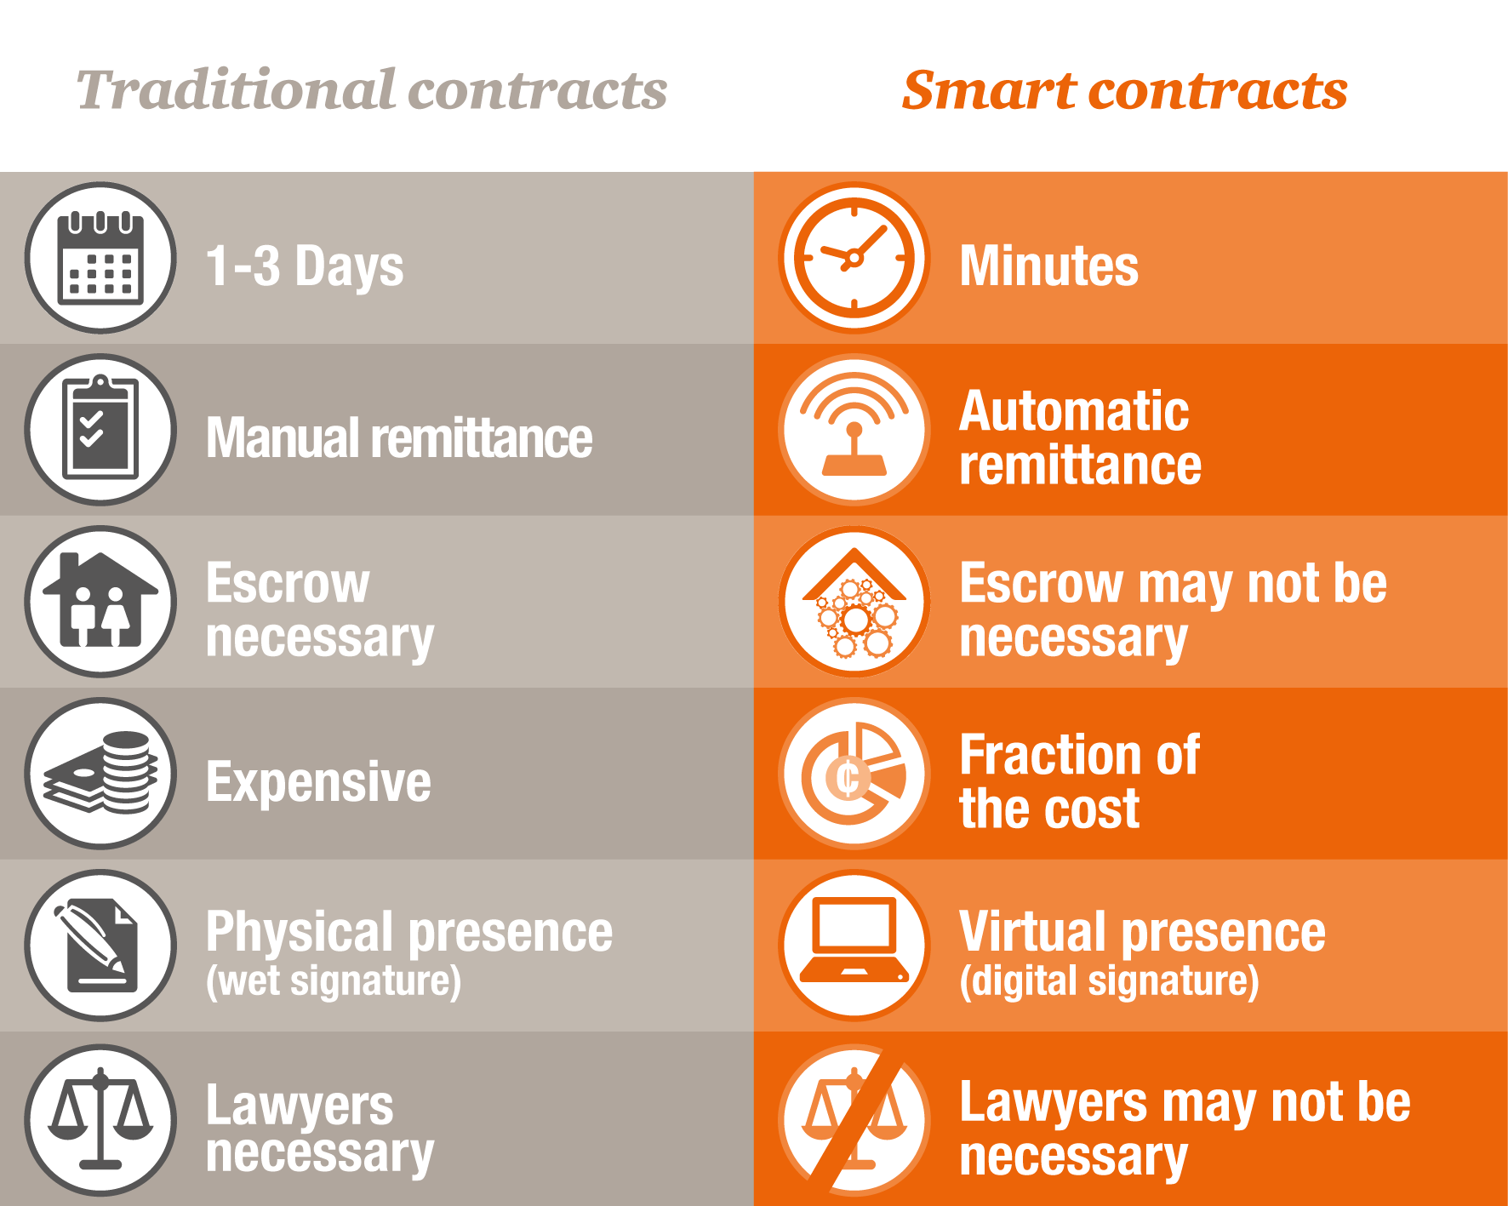
smart vs Traditional contract

Slide 22
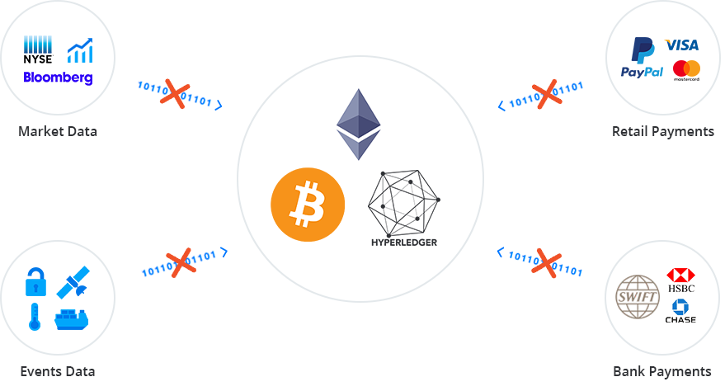
Connectivity Problem

Slide 23
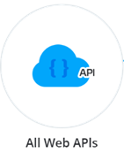
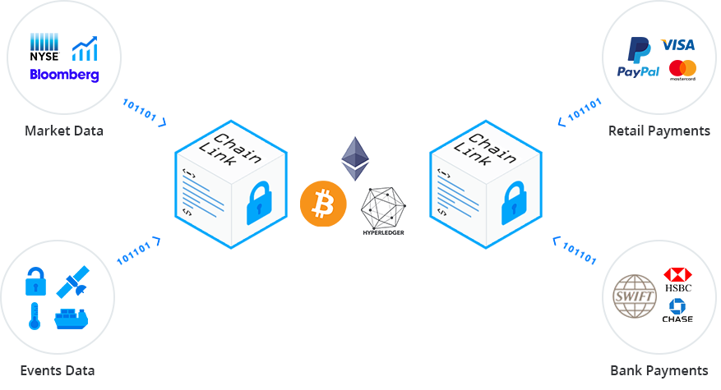


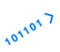
ChainLink

Slide 24
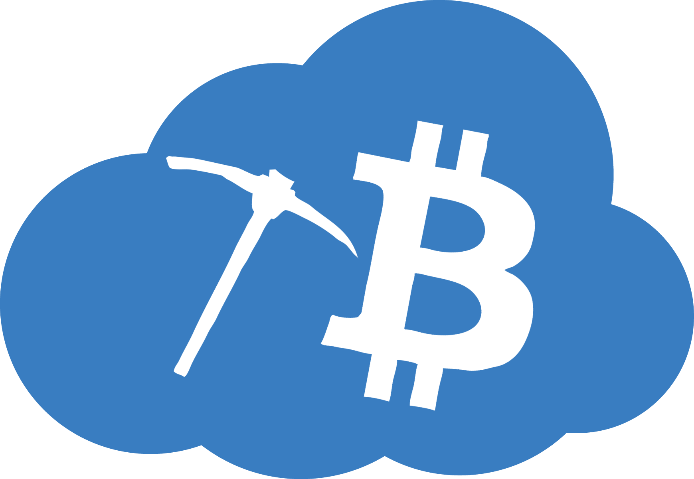


Cloud Mining
Cons
Pros
1
Risk of fraud
1
No constantly humming fans
No added electricity costs
1
Lower profit
1
Not being let down by mining equipment suppliers
1
Lack of control and flexibility
1

Slide 25
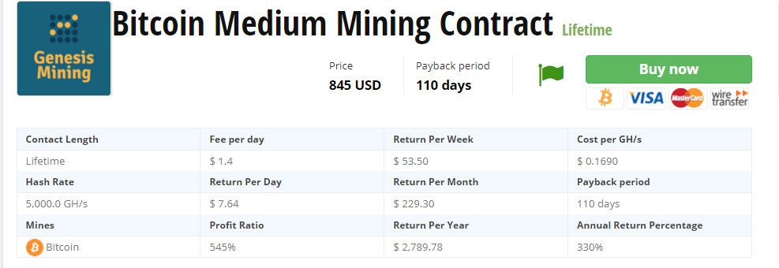
Genesis Platinum Mining Contract

Slide 26

Thank you
For listening

